Slide 1

Catalogue User Guide
2020 - 2021

Slide 2
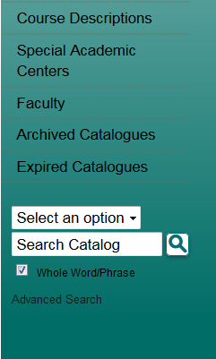

Catalogue Home Page
Use the left-hand navigation pane to select any section of the catalogue, including policies, programs, course descriptions, and specific schools and colleges.

Slide 3
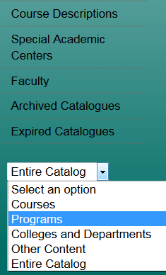
Catalogue Search Engine
Enter search terms and then select from the options in the drop-down menu at the lower left of the navigation bar to search all or specific sections of the catalogue.

Slide 4
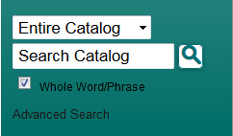
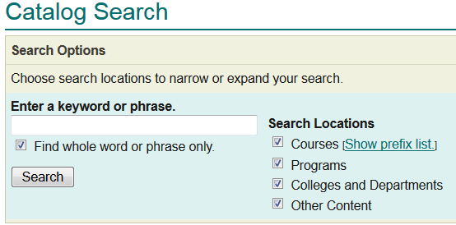
Search Options
Search options are available by clicking on the Advanced Search link below the regular search form or by clicking the Modify Search Options link after performing a search.
Advanced Search
To limit your search to only specific types of catalogue content, check only the checkboxes for content categories you wish to include in your search.

Slide 5
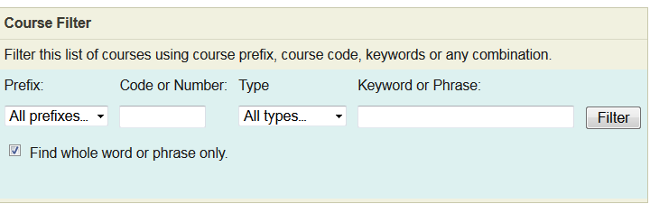
Course Search
Select Course Descriptions on the left navigation pane to search courses by prefix/subject, number etc.

Slide 6
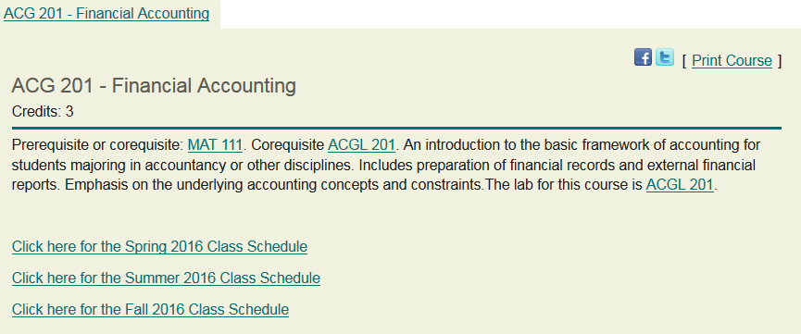
Course Details
Select the course title to expand the course details; select the title again to hide the information.

Slide 7
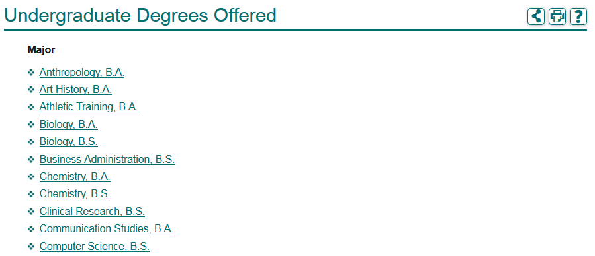
Degrees and Programs Offered
View an alphabetical listing of degrees and programs available. Click on Degree Programs and Requirements in left navigation pane and select the program you are interested in.

Slide 8
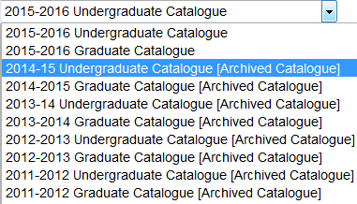
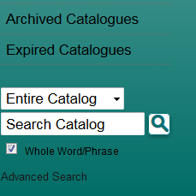
Looking for a different catalogue year?
Years 2011 – present are available via the drop-down menu on the top right of catalogue home page.
For all other years, see Archived or Expired Catalogues on the left-hand navigation pane.

Slide 9

Catalogue change icons
This icon indicates that a change has been made within the catalogue. Click the icon to review the original program information.

Slide 10
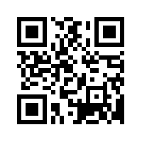
Access information on your mobile device
Scan this code to view our mobile app.

